Slide 1
C card churners data analysis
MENU
ANALYSIS
CONTACT
Group 3 (no pun indented)
Credit

Slide 2
Hello!
MENU
ANALYSIS
CONTACT
Data ANALYSIS
A presentation brought to you by:
No Pun Indented

Slide 3
INTRODUCTION
MENU
ANALYSIS
CONTACT
Data ANALYSIS
Looking at customer information from a bank
Using exploratory data analysis and comparisons
To gain insight into any customers that may churn

Slide 4
CONTENTS
MENU
ANALYSIS
CONTACT
Data ANALYSIS
Where did we find the dataset and how did we use it to answer our questions?
What questions are we asking and why?
The clean up and EDA process
Our conclusions and their implications

Slide 5
The Data
The dataset we were working with was from Kaggle (although originally from leaps.analyttica.com) and was comprised of information of customers who were under the banks’ credit card services.
The dataset consists of over 10,000 customers and hosts a wide variety of information.
This allowed us to look at several relationships within the data to identify any possible trends, that may allow us to predict which customers are more likely to churn.

Slide 6
Key questions
MENU
ANALYSIS
CONTACT
Can we compare gender and age to the attrition status of customers, to identify any trends?
How does the familial situation affect the attrition status of customers? Can we use gender, age, marital status and dependents to identify any correlation between familial situation and attrition status?
Does how long the customer has been inactive give any indication to whether a customer may leave? Using months inactive and months on book, can we recognize what may be a trigger point for customers leaving?
Is there a relationship between education and income levels - do higher education and income correlate? Are those with a higher income and higher education level more likely to stay with the bank? Are people with a lower income more likely to leave? (Does a high number of dependents and low income have any effect?)
What is the relationship between card category and income? Are those with a higher income on a better card, and are those on better cards more likely to stay or leave?
Do customers on higher income have higher transaction levels? Is there any correlation between transaction amounts and how long customers have been inactive?

Slide 7
and Visualisation
MENU
ANALYSIS
CONTACT
Data ANALYSIS
analysis

Slide 8
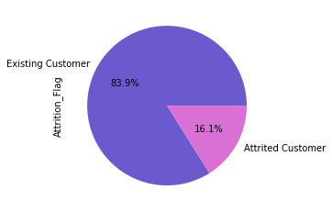
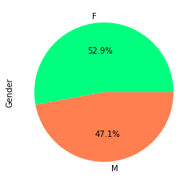
Question 1
The first question we looked at was to identify if there were any trends between customer age, gender and attrition status. We first used pie charts to allow for easy visualization. (They are nice to look at)

Slide 9
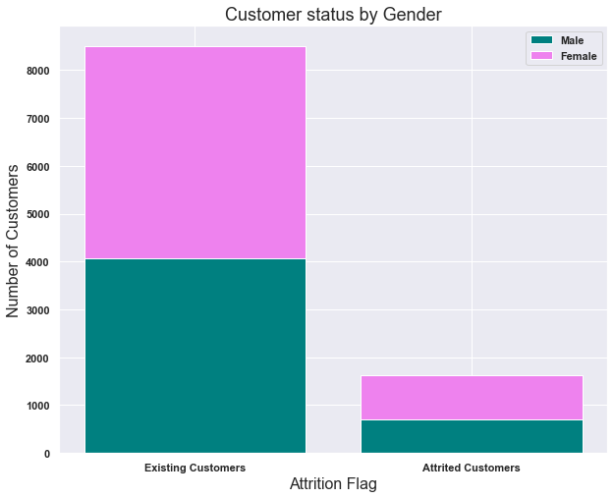
Question 1 cont.
We then created a stacked column chart to allow for comparison between the genders and the attrition status.

Slide 10
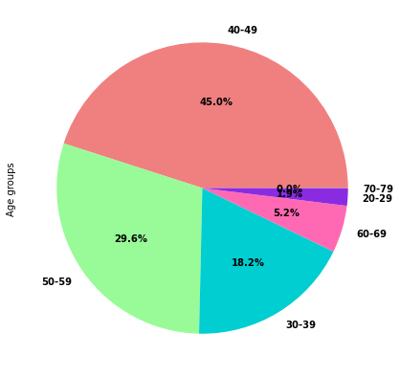
Question 1 cont. again
We then looked at the customer ages, by putting them in the bin. We first visualized the age groups with a pie chart.

Slide 11
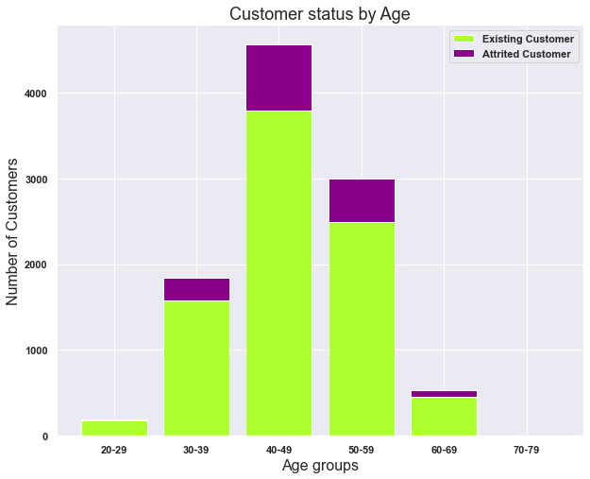
Question 1 cont. again
We then created a stacked column chart looking at the attrition status within the different age groups.

Slide 12
Question 1 conclusions
So, what do these visualizations tell us and what conclusions can we draw from this?

Slide 13
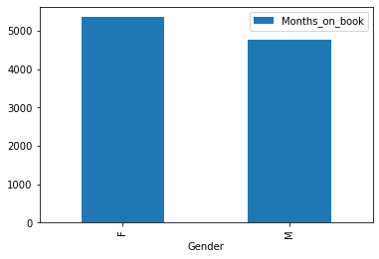
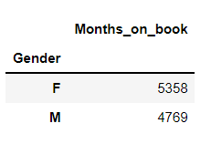
Question 2
Analysis of duration of staying with the bank based on gender of the customers
Does gender/age/marital status and dependents affect how long they have stayed with the bank?

Slide 14
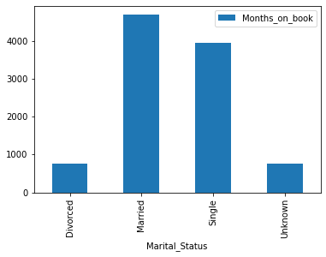
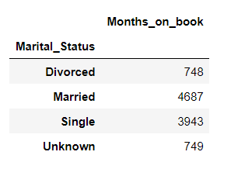
Question 2 cont.
Analysis of duration of staying with the bank based on marital status of the customers

Slide 15
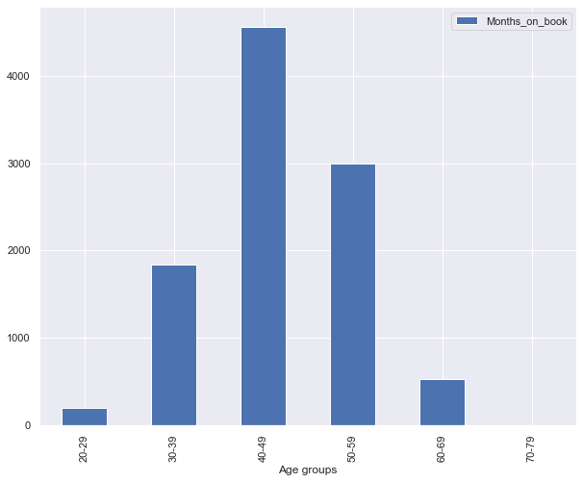
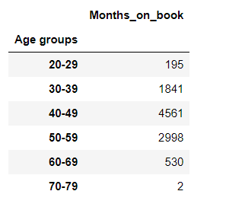
Question 2 cont.
Analysis of duration of staying with the bank based on age groups of the customers

Slide 16
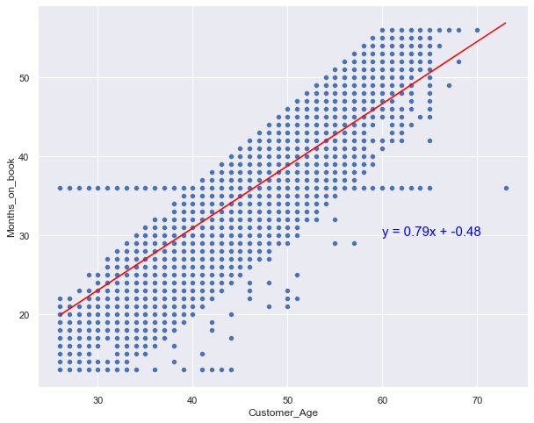
Question 2 cont.
Regression analysis of duration of staying with the bank against age of the customers.
As the customers grow older by a year, they tends to stay with the bank.
This suggests that increase in the age of the customer by a year will increase the period of staying with bank by 0.79%.

Slide 17
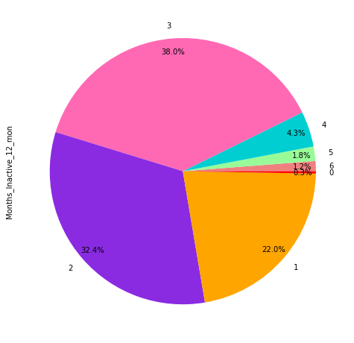
Question 3
The third question we are looking at is whether how long a customer has been inactive and how long they have been with the bank can give any indication of when a customer may leave.

Slide 18
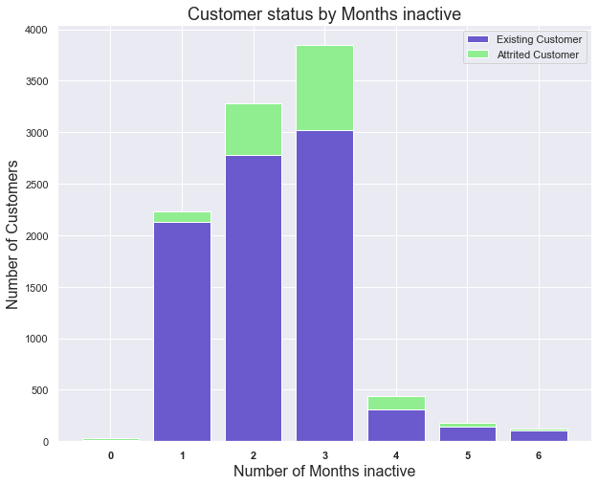
Question 3 cont.
We then created a stacked column chart to show the status of customers sorted by the months inactive.

Slide 19
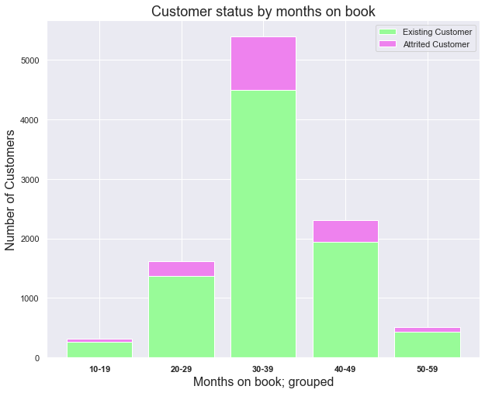
Question 3 cont.
We then created a stacked column chart to show the status of customers sorted by the months on the book.

Slide 20
Question 3 conclusions
So, what do these visualizations tell us and what conclusions can we draw from this?

Slide 21
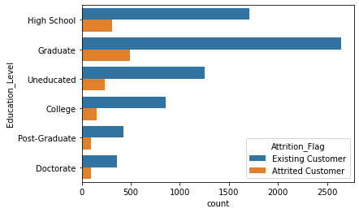
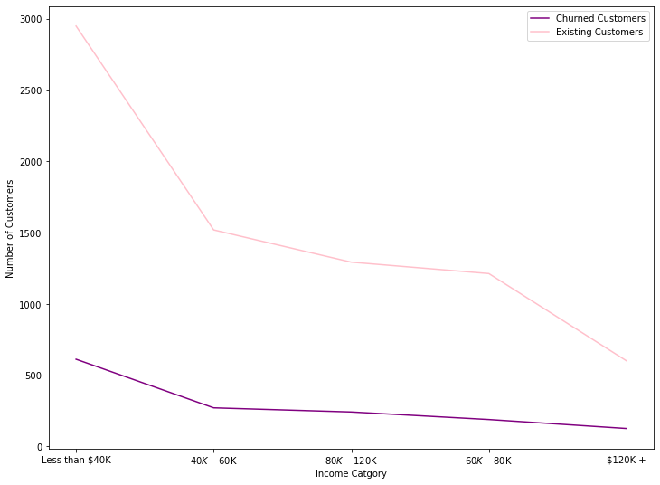
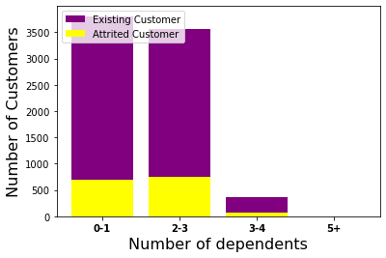
Question 4

Slide 22
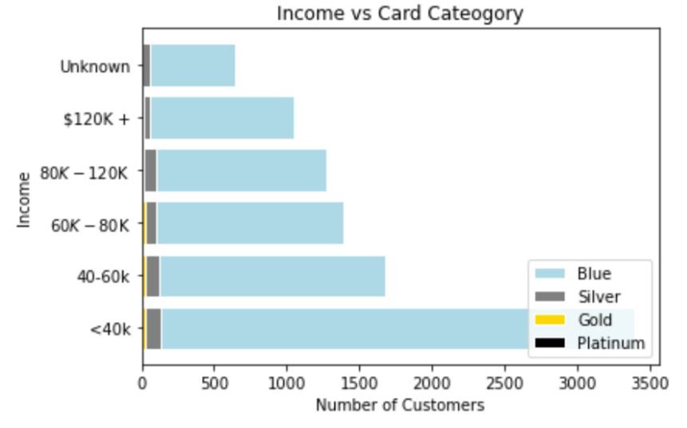
Question 5
Card category comparison against income.
Blue: 93.2%
Silver: 5.5%
Gold: 1.1%
Platinum: 0.2%

Slide 23
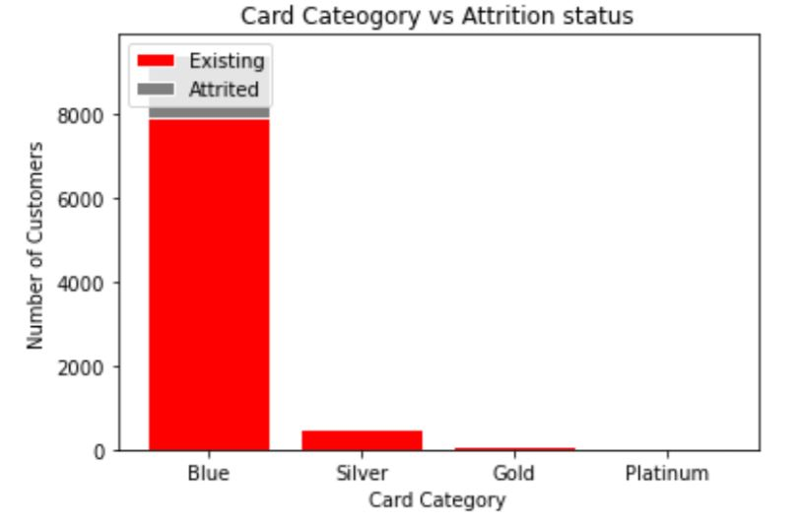
Question 5 cont.
Card category comparison against attrition.
EXISTING
Blue: 93.1%
Silver: 5.6%
Gold: 1.1%
Platinum: 0.2%
ATTRITED
93.4%
5.0%
1.3%
0.3%

Slide 24
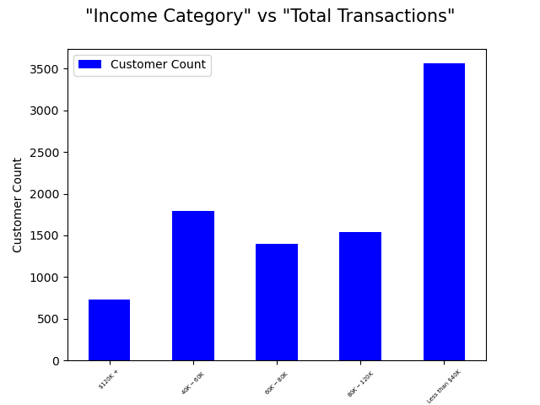
Question 6
Do customers on higher income have higher transaction levels? Is there any correlation between transaction amounts and how long customers have been inactive?
In the first part we analyzed a relationship between the income level vs. the customers
What conclusion do we draw here?

Slide 25
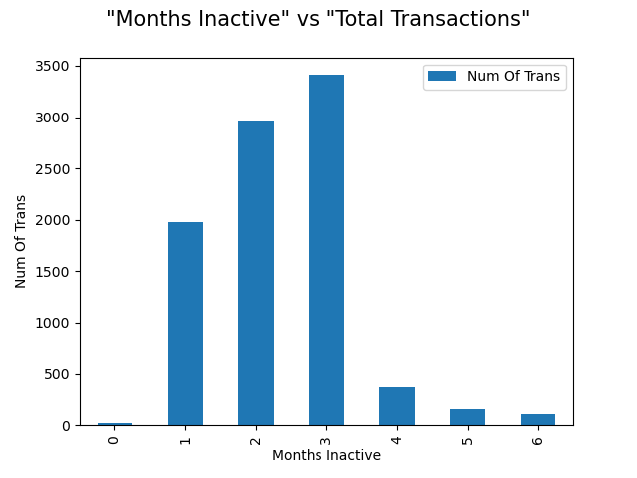
Question 6 CoNT
In the second part, a bar graph was created to show a relationship between the
In the second part we analyzed a relationship between number of transactions and Months Inactive.
What conclusion do we draw here?

Slide 26
Conclusions
Did we really achieve our objective of finding out which customers may churn?
What did we find out?
What could we do if we had more time and resources?

Slide 27
Any questions
MENU
ANALYSIS
CONTACT
Data ANALYSIS

